Slide 1
Input, Process, Output Session 1
Course : COMP6056
Effective Period : September 2021

Slide 2
Sub Topics
designing Programs
Input, Output, variables
Assignment and Calculations
Declaration and Data Types
Named Constant
Hand Tracing a program
Documenting a program
Designing your first program

Slide 3
These slides have been adapted from: Gaddis, T. (2019). Starting Out with Programming Logic and Design 5^{th.} ISBN: 978-0-13-480115-5 Chapter 2
Acknowledgement

Slide 4
Learning Objectives
At the end of this lecture, students are able to:
LO1: To explain the program development cycle
LO2: To write pseudo-code to solve simple problem

Slide 5
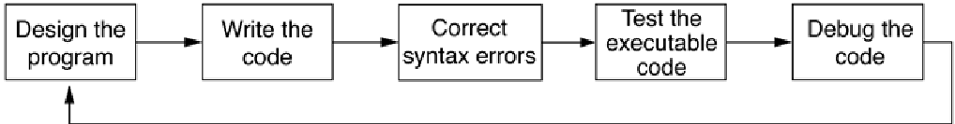
Designing a Program
The program development cycle
Gaddis, T., Starting Out With Programming Logic and Design, 5 ed, ISBN: 978-0-13-480115-5

Slide 6
Designing a Program
Two steps in designing a program
Understand the tasks that the program is to perform.
Learning what the customer wants.
Determine the steps that must be taken to perform the task.
Create an algorithm, or step-by-step directions to solve the problem.
Use flowcharts and/or pseudocode to solve.
Gaddis, T., Starting Out With Programming Logic and Design, 5 ed, ISBN: 978-0-13-480115-5

Slide 7
Designing a Program
Gaddis, T., Starting Out With Programming Logic and Design, 5 ed, ISBN: 978-0-13-480115-5

Slide 8
Designing a Program
Pseudocode
Fake code used as a model for programs
No syntax rules
Well written pseudocode can be easily translated to actual code
1.Display “Enter the number of hours”
2.Input hours
3.Display “Enter the hourly pay rate”
4.Input payRate
5.Set grossPay = hours * payRate
6.Display “The gross pay is $”, grossPay
Gaddis, T., Starting Out With Programming Logic and Design, 5 ed, ISBN: 978-0-13-480115-5

Slide 9
Designing a Program
Flowcharts
A diagram that graphically depicts the steps that take place in a program
Terminator used for start and stop
Parallelogram used for input and output
Rectangle used for processes
Flow
Gaddis, T., Starting Out With Programming Logic and Design, 5 ed, ISBN: 978-0-13-480115-5

Slide 10
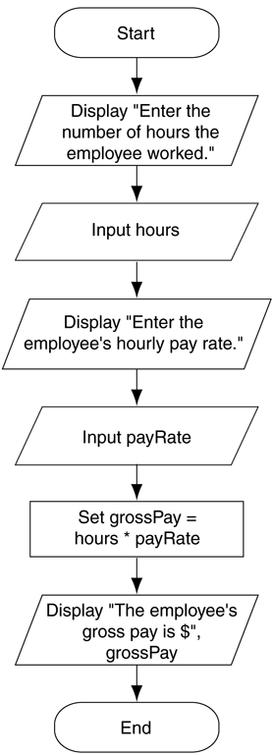
Designing a Program
Example:
Flowchart for the pay calculating program
Gaddis, T., Starting Out With Programming Logic and Design, 5 ed, ISBN: 978-0-13-480115-5

Slide 11
Output, Input, and Variables
Output – data that is generated and displayed
Input – data that a program receives
Variables – storage locations in memory for data
Computer programs typically follow 3 steps
Input is received
Some process is performed on the input
Output is produced
Gaddis, T., Starting Out With Programming Logic and Design, 5 ed, ISBN: 978-0-13-480115-5

Slide 12
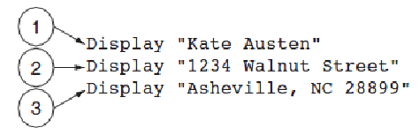
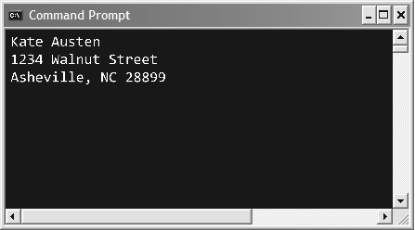
Output, Input, and Variables
Display is the keyword to show output to the screen
Sequence – lines execute in the order they appear
String Literals – a sequence of characters
The statements execute in order
Output of Program 2-1
Gaddis, T., Starting Out With Programming Logic and Design, 5 ed, ISBN: 978-0-13-480115-5

Slide 13
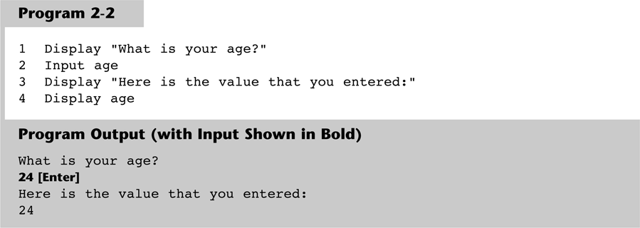
Output, Input, and Variables
Input is the keyword to take values from the user of the program
It is usually stored in variables
Gaddis, T., Starting Out With Programming Logic and Design, 5 ed, ISBN: 978-0-13-480115-5

Slide 14
Output, Input, and Variables
Programmers can define variable names following certain rules
Must be one word, no spaces
Generally, punctuation characters are avoided
Generally, the first character cannot be a number
Name a variable something that indicates what may be stored in it
camelCase is popular naming convention
Gaddis, T., Starting Out With Programming Logic and Design, 5 ed, ISBN: 978-0-13-480115-5

Slide 15
Output, Input, and Variables
IPO Charts
Gaddis, T., Starting Out With Programming Logic and Design, 5 ed, ISBN: 978-0-13-480115-5

Slide 16
Output, Input, and Variables
Strings and Literals
String appear in actual code
Usually enclosed in double quote mark
Gaddis, T., Starting Out With Programming Logic and Design, 5 ed, ISBN: 978-0-13-480115-5

Slide 17
Output, Input, and Variables
Strings and Literals
String appear in actual code
Usually enclosed in double quote mark
Gaddis, T., Starting Out With Programming Logic and Design, 5 ed, ISBN: 978-0-13-480115-5

Slide 18
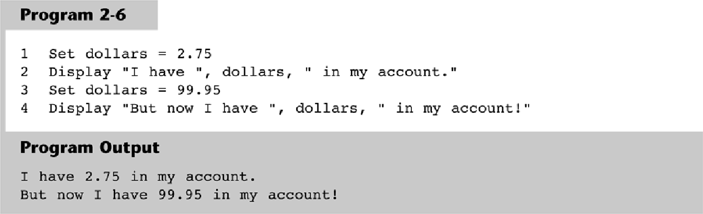
Output, Input, and Variables
Variable Assignment & Calculations
Variable assignment can come from user input and also can be set through an assignment statement
set price = 20 or set price to 20
Gaddis, T., Starting Out With Programming Logic and Design, 5 ed, ISBN: 978-0-13-480115-5

Slide 19
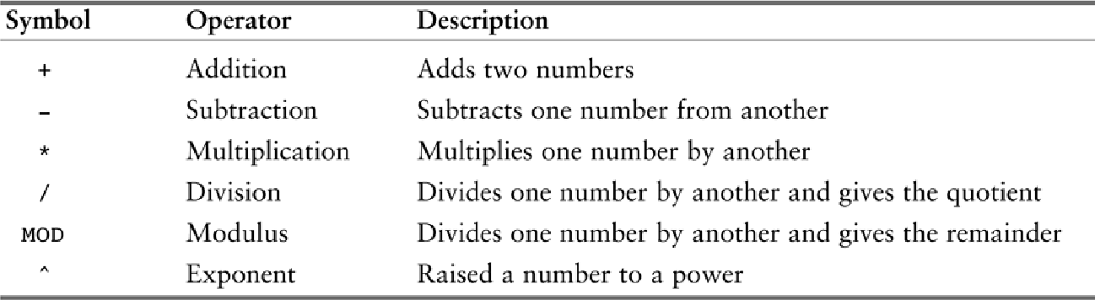
Output, Input, and Variables
Calculations are performed using math operators
The expression is normally stored in variables
Set sale = price – discount
Common math operators
Gaddis, T., Starting Out With Programming Logic and Design, 5 ed, ISBN: 978-0-13-480115-5

Slide 20
Output, Input, and Variables
Variable Declarations & Data Types
A variable declaration includes a variable’s name and a variable’s data type
Data Type – defines the type of data you intend to store in a variable
Integer – stores only whole numbers
Real – stores whole or decimal numbers
String – any series of characters
Character – one character only
Example: Declare Real grossPay
Gaddis, T., Starting Out With Programming Logic and Design, 5 ed, ISBN: 978-0-13-480115-5

Slide 21
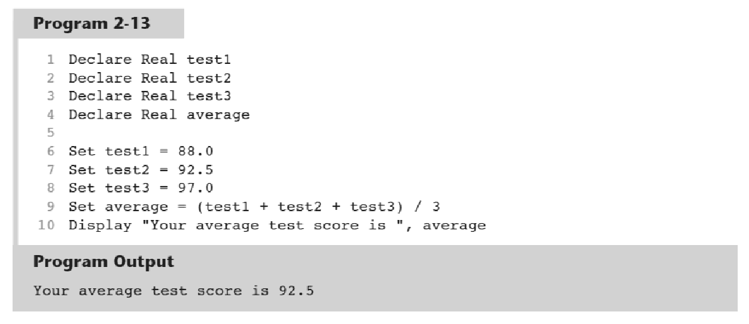
Output, Input, and Variables
For safety and to avoid logic errors, variables should be initialized to 0 or some other value
Gaddis, T., Starting Out With Programming Logic and Design, 5 ed, ISBN: 978-0-13-480115-5

Slide 22
Named Constants
A named constant is a name that represents a value that cannot be changed
Makes programs more self explanatory
If a change to the value occurs, it only has to be modified in one place
Constant Real INTEREST_RATE = 0.069
Gaddis, T., Starting Out With Programming Logic and Design, 5 ed, ISBN: 978-0-13-480115-5

Slide 23
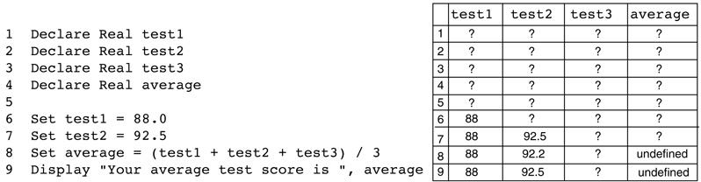
Hand Tracing a Program
Hand tracing is a simple debugging process for locating hard to find errors in a program or to ensure the correctness of a program
Involves creating a chart with a column for each variable, and a row for each line of code
Gaddis, T., Starting Out With Programming Logic and Design, 5 ed, ISBN: 978-0-13-480115-5

Slide 24
Documenting a Program
External documentation describes aspects of the program for the user, sometimes written by a technical writer
Internal documentation explains how parts of the program works for the programmer, also known as comments
// comments are often distinguished within
// the program with line comments
Gaddis, T., Starting Out With Programming Logic and Design, 5 ed, ISBN: 978-0-13-480115-5

Slide 25
Designing Your First Program
Calculate the batting average for any player
Batting Average = Hits ÷ Times at Bat
Determine what is required for each phase of the program:
What must be read as input?
What will be done with the input?
What will be the output?
Gaddis, T., Starting Out With Programming Logic and Design, 5 ed, ISBN: 978-0-13-480115-5

Slide 26
Designing Your First Program
Input is received.
The number of hits
The number of times at bat
Some process is performed on the input.
Calculate the batting average
Divide the number of hits by the number of times at bat
Output is produced.
The player’s batting average
Gaddis, T., Starting Out With Programming Logic and Design, 5 ed, ISBN: 978-0-13-480115-5

Slide 27
Designing Your First Program
IPO Chart
Gaddis, T., Starting Out With Programming Logic and Design, 5 ed, ISBN: 978-0-13-480115-5

Slide 28
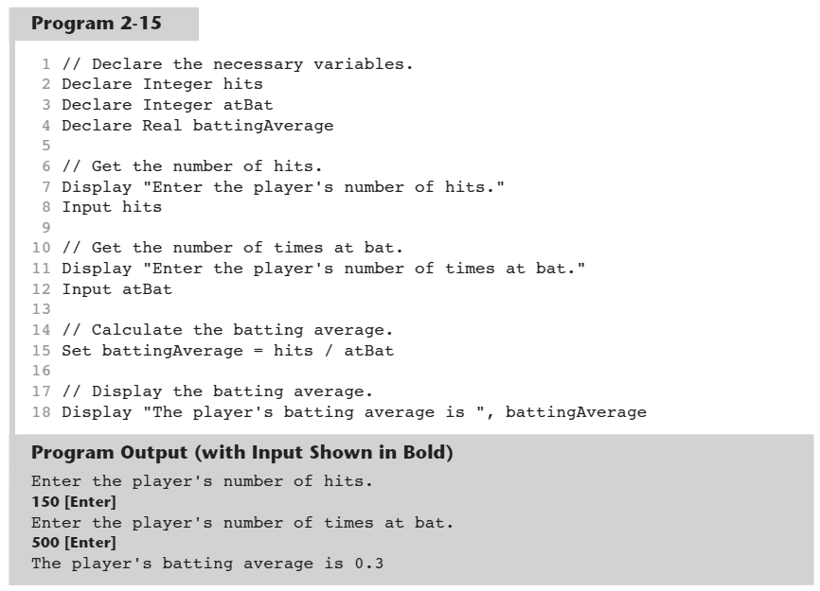
Designing Your First Program
Pseudocode
Gaddis, T., Starting Out With Programming Logic and Design, 5 ed, ISBN: 978-0-13-480115-5

Slide 29
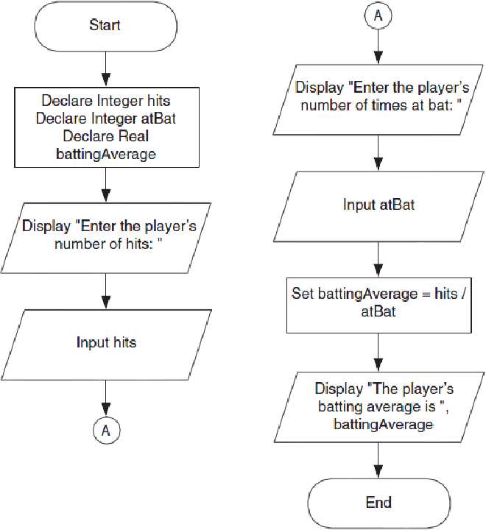
Designing Your First Program
Flowchart
Gaddis, T., Starting Out With Programming Logic and Design, 5 ed, ISBN: 978-0-13-480115-5

Slide 30
Designing Your First Program
Hand Tracing
Gaddis, T., Starting Out With Programming Logic and Design, 5 ed, ISBN: 978-0-13-480115-5

Slide 31
References
Gaddis, T. (2019). Starting Out with Programming Logic and Design 5th. ISBN: 978-0-13-480115-5

